Slide 1
What and How Well You Performed? A Multitask Learning Approach to Action Quality Assessment
Paritosh Parmar, Brendan Tran Morris
University of Nevada, Las Vegas
CVPR2019

Slide 2
Definition
Multitask:
a single model caters to more than a single task
a common body that branches into task-specific heads
main task & auxiliary tasks
detailed action classification
generate action quality score
generate a commentary of performance
AQA

Slide 3
Motivation
Current AQA and skills assessment approaches propose to learn features that serve only one task - estimating the final score.
Using extra information in training has been proven to be useful.

Slide 4
Related Works
AQA:
i) non machine learning encoders + regressor: rely solely on pose features, neglect important visual quality cues
ii) C3D: capture appearance and salient motions
Skills Assessment:
i) spatio-temporal interest points (STIP's) in frequency domain
ii) convolutional features
iii) temporal attention, spatial attention

Slide 5
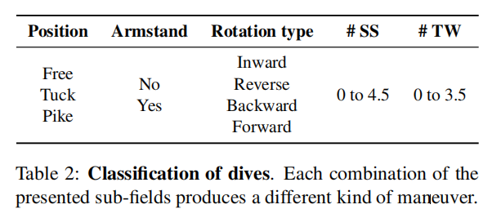
Multitask AQA Dataset

Slide 6
MTL-AQA (Origin of two auxiliary tasks)
what action was carried out
detailed action classification
Action Quality
how well that action was executed
a verbal description

Slide 7
MTL-AQA (C3D-AVG)

Slide 8
MTL-AQA (C3D-AVG)
Ref: Du Tran, Lubomir Bourdev, Rob Fergus, Lorenzo Torresani,and Manohar Paluri. Learning spatiotemporal features with 3d convolutional networks. ICCV 2015

Slide 9
MTL-AQA (C3D-AVG)
?

Slide 10
MTL-AQA (Loss functions)
AQA Task:
Classification Task:
Captioning Task:
Overall:

Slide 11
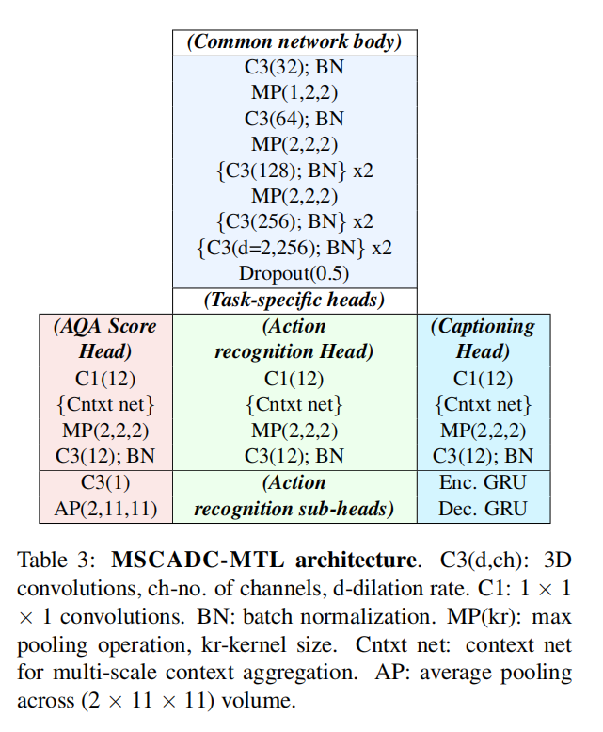
MTL-AQA (MSCADC)
Multiscale Context Aggregation with Dilated Convolutions
input: downsample 96-frame videos to 16 key action frames
Ref: Fisher Yu and Vladlen Koltun. Multi-scale context aggregation by dilated convolutions. ICLR 2016

Slide 12
Output

Slide 13
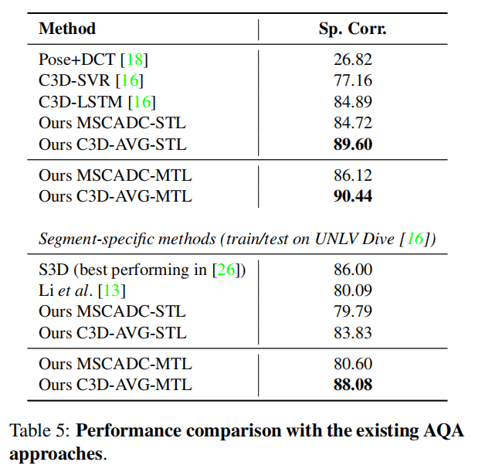
Experiments

Slide 14
Experiments
I love white cats.
I love white white cats.
Bn: BLEU (Bilingual Evaluation Understudy)
M: Meteor
R: ROUGE (Recall-Oriented Understudy for Gisting Evaluation)
C: CIDEr (Consensus-based Image Description Evaluation)

Slide 15
Experiments

Slide 16
Experiments

Slide 17
Conclusion
+ the first to introduce multi-task into AQA and the approach is general
+ contributed the largest AQA dataset
+ related to NLP to some extent
- can't explain the averaging operation before classifier
- just combined different models and didn't give any description for some of these models

Slide 18
References
Du Tran, Lubomir Bourdev, Rob Fergus, Lorenzo Torresani,and Manohar Paluri. Learning spatiotemporal features with 3d convolutional networks. ICCV 2015
Fisher Yu and Vladlen Koltun. Multi-scale context aggregation by dilated convolutions. ICLR 2016
https://www.cnblogs.com/Determined22/p/6910277.html
Oriol Vinyals Google, Alexander Toshev, Samy Bengio, Dumitru Erhan. Show and Tell: A Neural Image Caption Generator. CVPR 2015

